Slide 1
SurveyX Crowd Opinion Mining and Rewarding
A Scalable Prediction Market Use Case

Slide 2
Two Components
SurveyX
Crowd Opinion
Mining and Rewarding
NonRepudiationX
(NRX)
A BlockChain Scalability Solution

Slide 3

SurveyX
Crowd opinion mining and rewarding

Slide 4
SurveyX
Facilitates crowd opinion mining and incentivization
Participants get rewarded by the Surveyor based on an early announced selection criteria or a random equation (with a help of an Oracle).
It is not a prediction market use-case. But, it is a nice example of how some projects could be modeled and built as a Prediction Market with Gnosis.

Slide 5
SurveyX – POC
A POC is currently deployed on Rinkeby Testnet and available at http://surveyx.io
It is built with React, Truffle 5 and solidity 0.5. The code is available at https://github.com/apper-tech/surveyx
It will be reimplemented with Gnosis Mercury and NonRedpudationX.

Slide 6
SurveyX – POC Actors & Use Cases
Surveyor
Create a survey
The survey by design is very similar to prediction market (categorical or scalar)
Share the survey link with Participants
With up to date information about the survey data and results
End a survey
When the surveyor is happy with his result he can opt to end the survey which, in the POC, gives, the surveyor, the address of the winner to transfer the prize.

Slide 7
SurveyX – POC Actors & Use Cases
Participant
Participate in a Survey
The user can browser the DApp link (contains the survey id/code) and fill the form.
Win the prize pool
At the POC the surveyor has to transfer the reward.
Later on, with a help on an Oracle, with the help of a set of user selected parameters, an algorithm will be used to select the winner, who in turn will receive the winnings at the end of the survey time.

Slide 8
SurveyX POC Screenshots

Slide 9
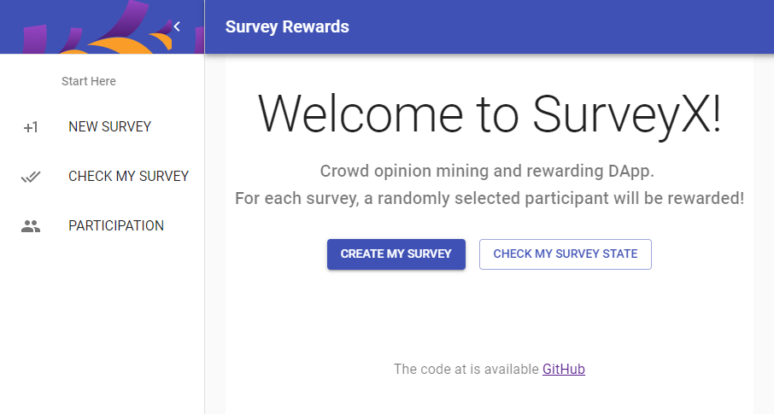
SurveyX – Landing Page
The page after the user nominate himself/herself.

Slide 10
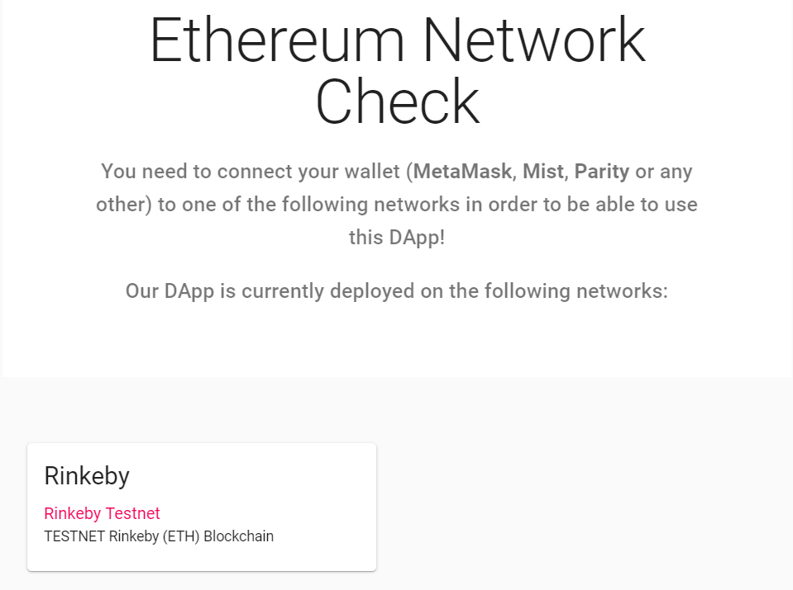
SurveyX – Connectivity Page

Slide 11
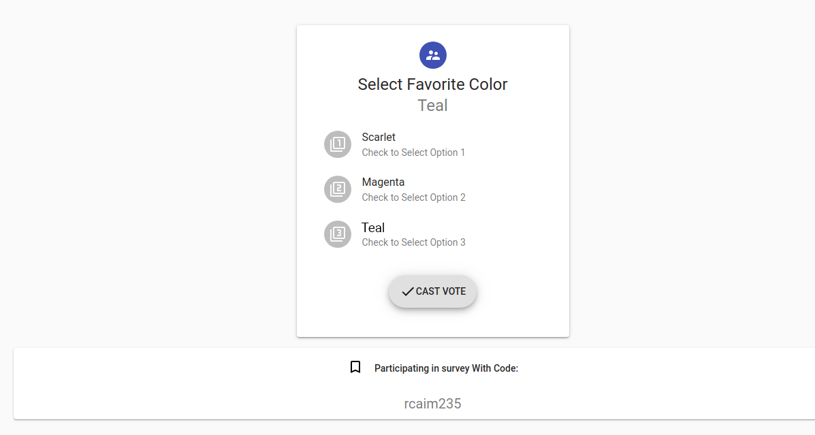
SurveyX – Participation Page
This is simplified at the POC. However, later on there will be a dynamic form builder

Slide 12
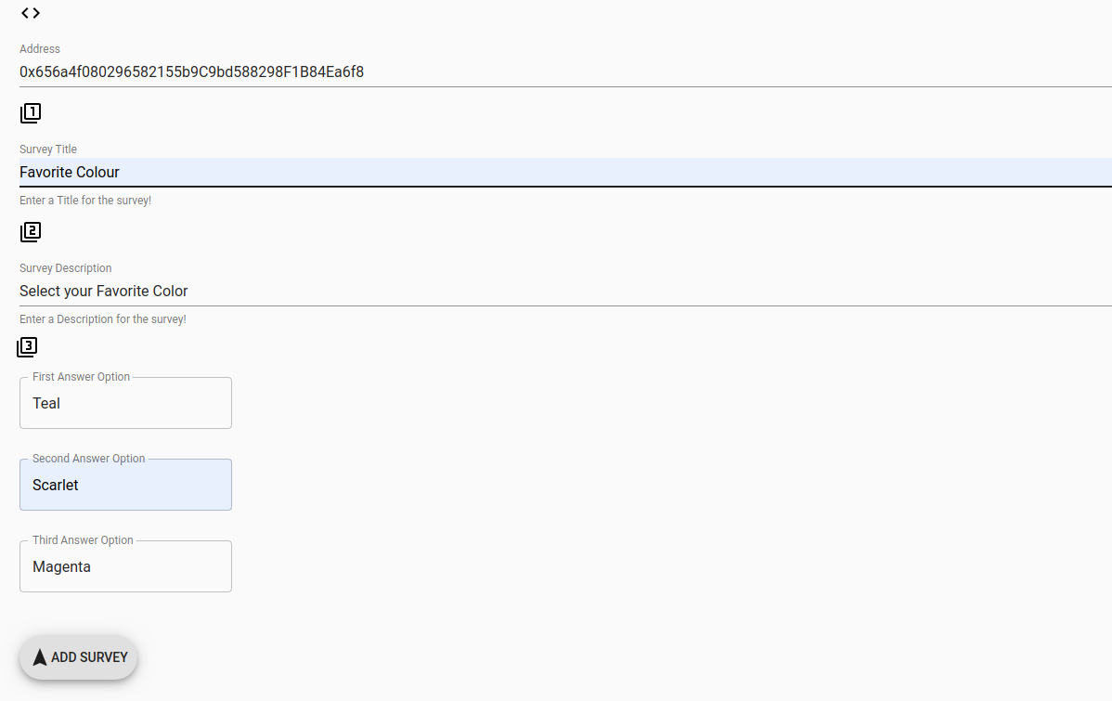
SurveyX – Survey Creation Page

Slide 13
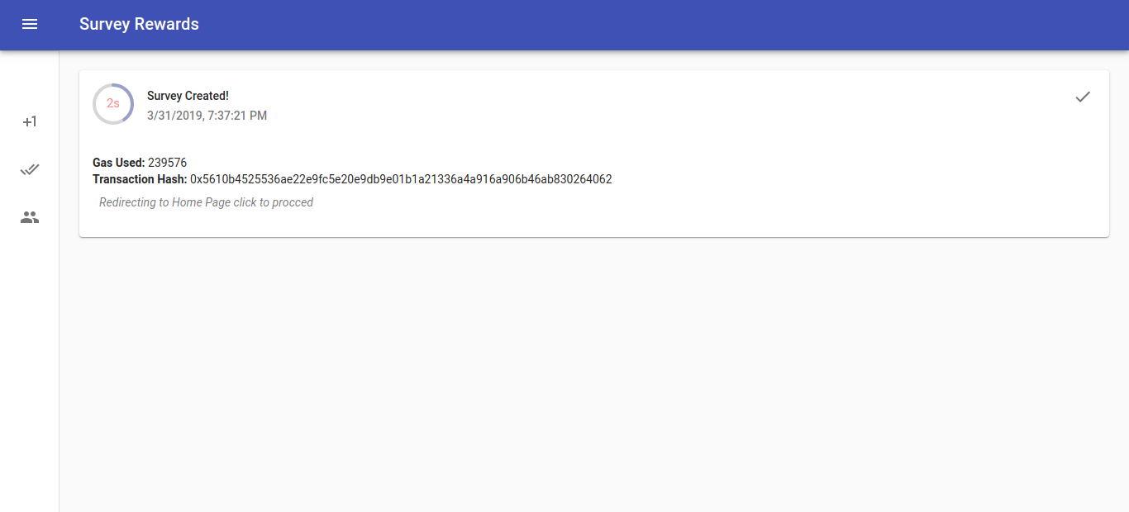
SurveyX – Survey Created Page

Slide 14
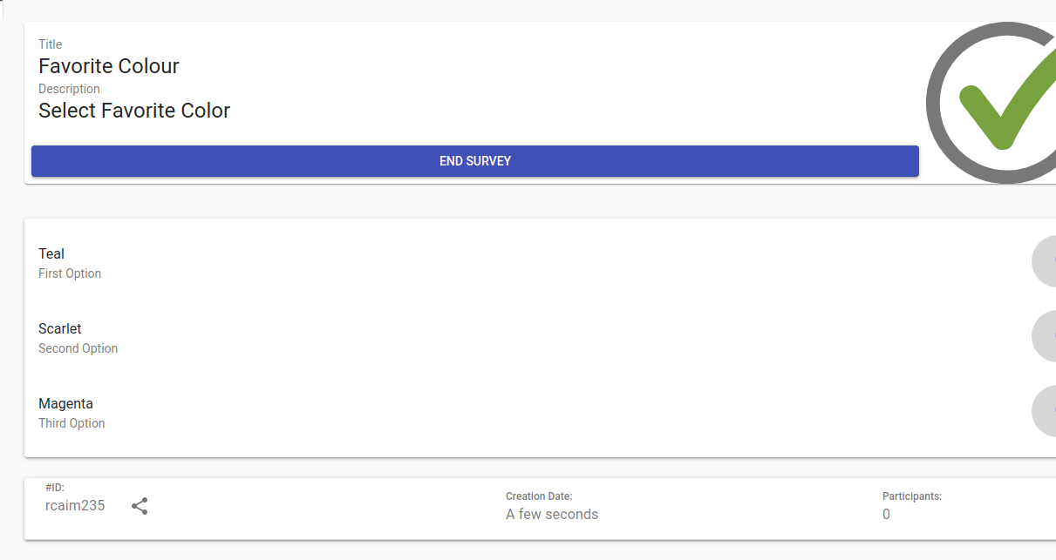
SurveyX – Survey Management Page

Slide 15
NonRepudiationX
A BlockChain Scalability Solution that can leverage Prediction Markets
NRX

Slide 16
NonRepudiationX – Why?
BlockChain till now did not reach mass-adoption.
Two of the main reasons for that are the scalability (limited number of transactions per second) and the cost (transaction cost is relatively high).
Ethereum storage exceeded 1 TB. This is an alert for the community that should encourage a wise storage usage.

Slide 17
NonRepudiationX – What?
NRX depends on using off-chain non-repudiation communication, that could be claimed on-chain.
It is BlockChain scalability solution that best fit for prediction markets and can leverage Gnosis Mercury and expose it to more use-cases.
It increases the speed in addition to lowering the cost paid by the end user.

Slide 18
NonRepudiationX – Results
It will Enable the users to vote, participate in surveys and do any other prediction market participation activities for free.
And the users will only pay for the transaction when they will claim their rewards (if there is any).
It causes less transactions to be saved on Ethereum that exceeded 1 TB.

Slide 19
Sequence Diagram
NRX

Slide 20
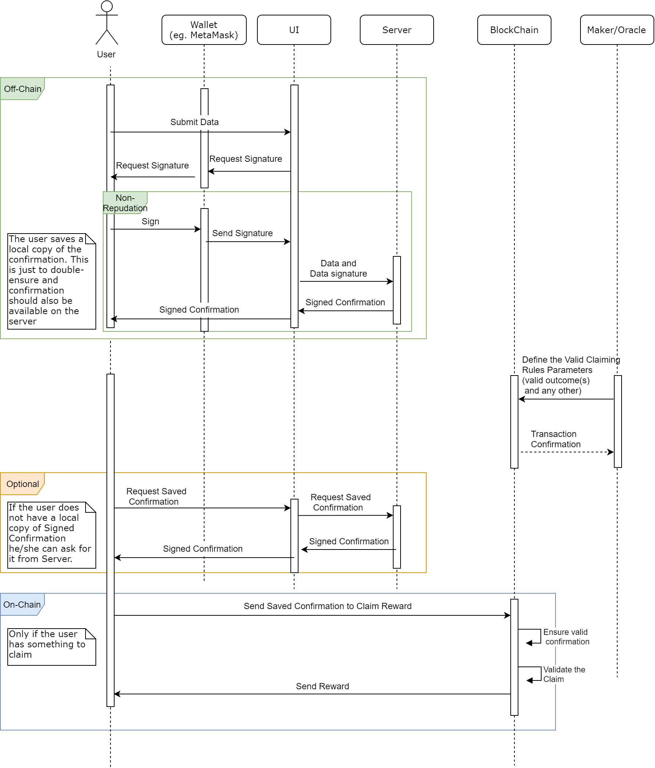

Slide 21
NonRepudiationX - How
The off-chain signature will be done in compliance of the EIP712 standard that is already implemented in MetaMask.
Solidity have `ecrecover` function that can be used for on-chain verification. (OpenZeppelin provided a standard hash-verification library: https://docs.openzeppelin.org/docs/cryptography_ecdsa)

Slide 22
NonRepudiationX - Conclusion
We think that SurveyX, like almost all other use-cases that could be built with Gnosis Prediction Market, will stay under the hood, if they were not provided with a scalability solution.
And we believe that NonRepudiationX is fairly simple, yet powerful enough, and best fit for a prediction market. And it can attract developers and end-users to use Gnosis Mercury and the solutions built with

Slide 23
Core Team
Muhammad Altabba - Team Lead
Full Stack BlockChain Developer with solid and extensive commercial experience in Web Application development.
LinkedIn: https://www.linkedin.com/in/muhammadaltabba/
Stack Overflow: https://stackoverflow.com/users/8303489
Ethereum Stack Exchange: https://ethereum.stackexchange.com/users/23253
GitHub: https://github.com/Muhammad-Altabba
BlockChain Articles: https://medium.com/@maltabba

Slide 24
Core Team
Muhammed Mazen Hafez - Full-Stack Developer
Full-stack web and blockchain developer. He is faster learner and he has been working on this field since 2015 on various web platforms.
LinkedIn: https://www.linkedin.com/in/mhmazen/
GitHub: https://github.com/mh-mazen

Slide 25
Core Team
Qamar Alzaman Hafez - System Analyst
Has BCS in Information Technology engineering, specialized in AI.
Skilled in Software Design, Maintenance, Development Process and Architecture.
LinkedIn: https://www.linkedin.com/in/qamaral-zamanhafez/
GitHub: https://github.com/Nayoshca

Slide 26
Milestones & Deliverables
The work will span on 6 to 9 months divided into 3 phases.
Asking Gnosis for a grant of
56 000 USD

Slide 27
Milestones, and Deliverables Phase I - Core Features
Deliverables
SurveyX beta version (includes survey builder).
Implement NonRepudiationX in SurveyX.
Document and encourage using NonRepudiationX for Prediction Markets built with Gnosis.
Time Estimate: 2 to 3 months
Time Estimate: 2 to 3 months

Slide 28
Phase II – Enhancements, Stabilization and Code Refactoring
Deliverables
Heavy testing and bugs fixes.
Deploy to Ethereum main net.
Implement additional features like reports, a dashboard and etc...
Design and implement a business model.
Time Estimate: 2 to 3 months

Slide 29
Phase III
Final Technical Touches, Community Building, and Business Model Fine-Tuning.
This phase is where we will look more for achievements from a business point of view.
How much effect we could make, is a proof of a good technical solution in addition to smart work.
Time Estimate: 2 to 3 months

Slide 30
Phase III – Deliverables 1/2
Reach at least 1000 users on SurveyX.io
In addition to the above, ensure a successful achievement to at least 3 of the following numbers:
10 enhancements or feature-requests implementation for opened issues for SurveyX on github.com

Slide 31
Phase III – Deliverables 1/2
1000 viewers for YouTube marketing and/or technical video(s).
1000 viewers for Medium article(s).
One or more published research paper (most likely about NonRepudationX) in an academic journal or conference.
At least 1 partnership.

Slide 32
What is after those Phases
Ensure a revenue stream that keeps the business running and expanding…
Raise fund and use it to gain more market share…

Slide 33
Why to Fund SurveyX
A scalable use case built with Gnosis for a multibillion USD business.
NonRepudiationX is reusable with all prediction market cases.

Slide 34
Thanks!
Questions!

